Slide 1

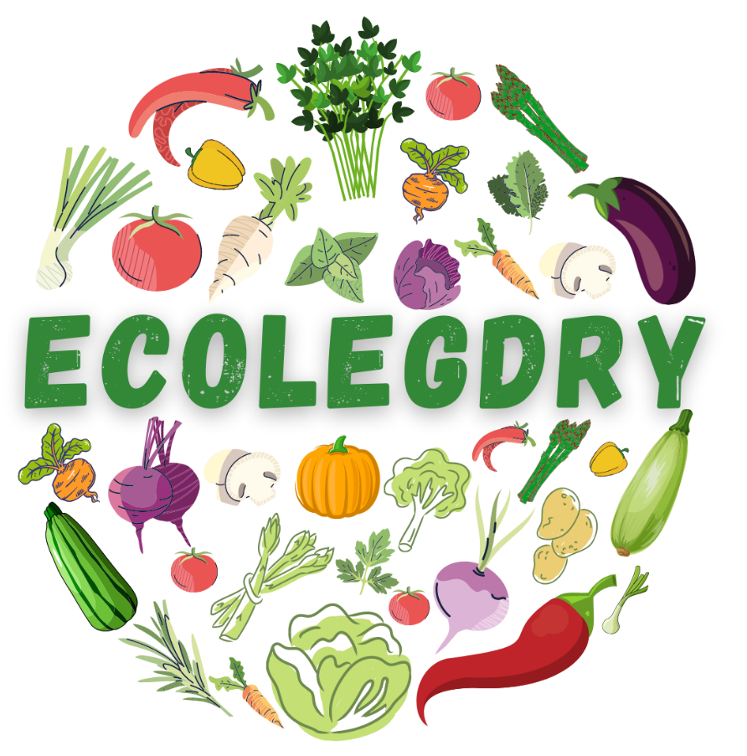

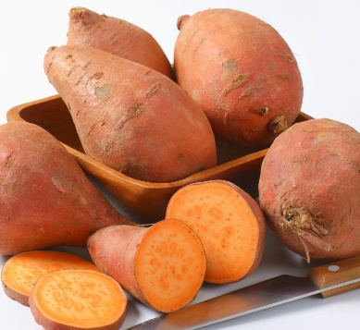
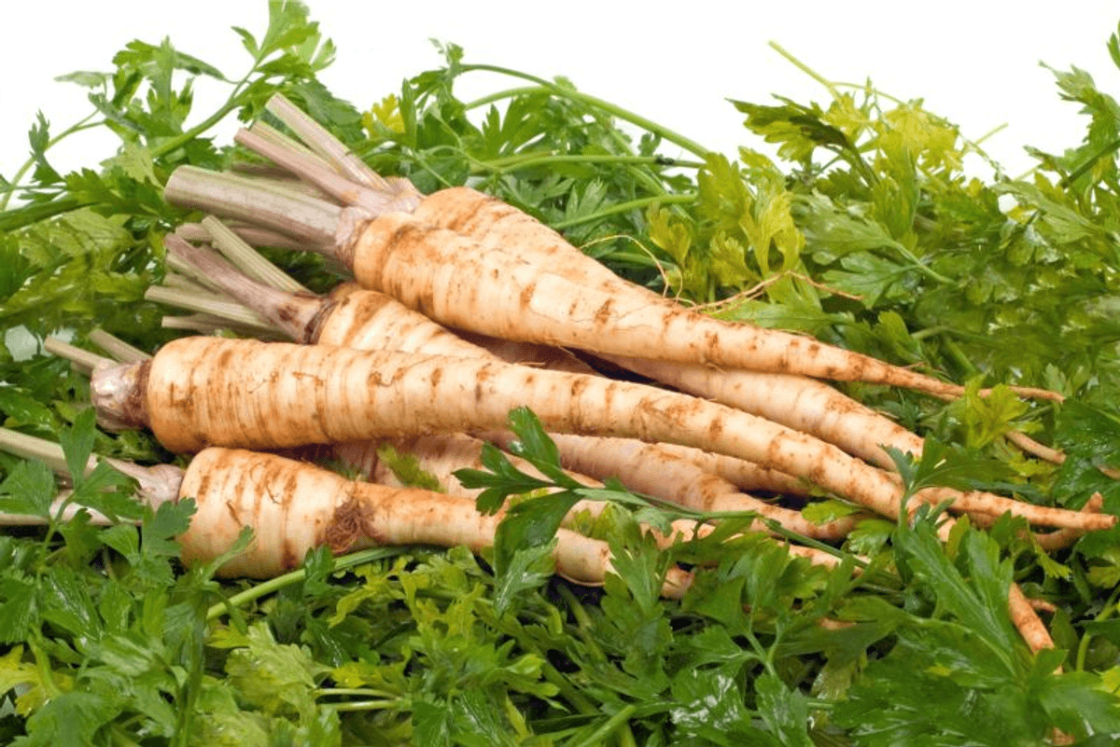
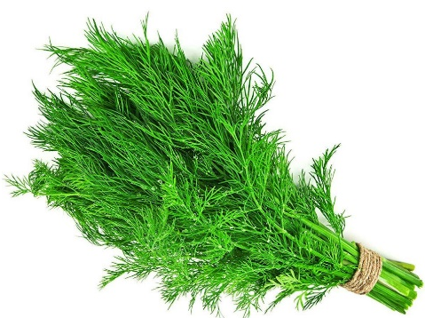
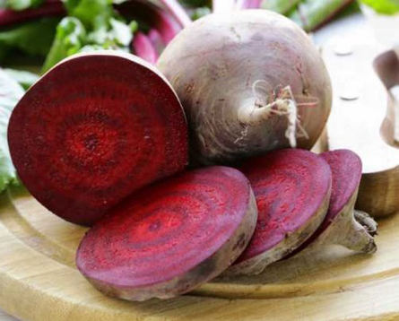
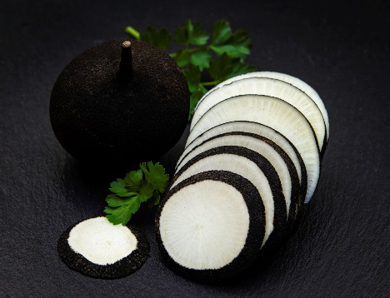
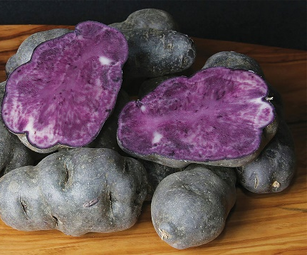
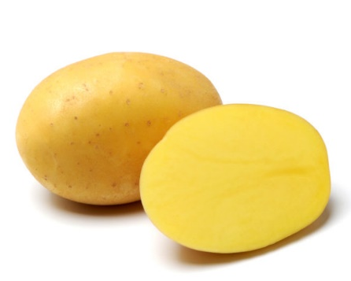
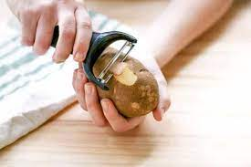
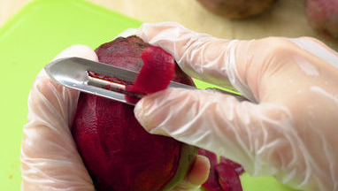
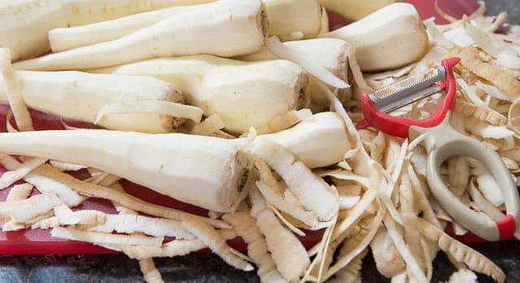
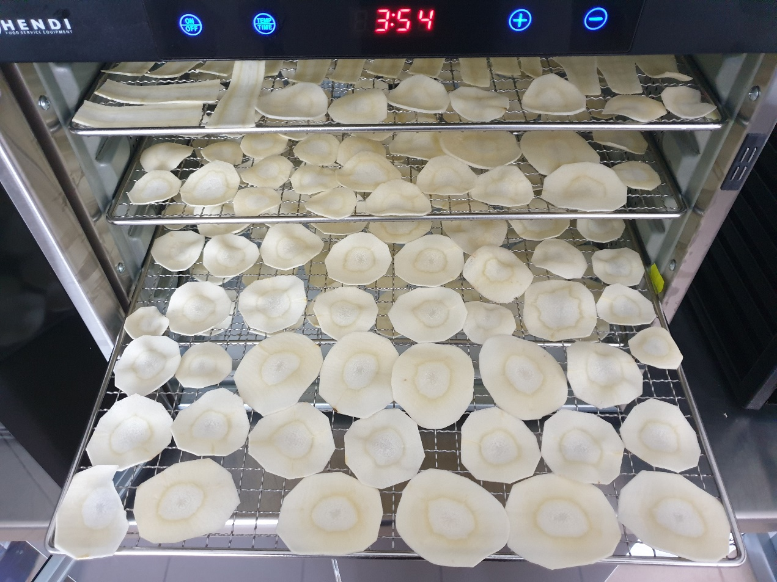
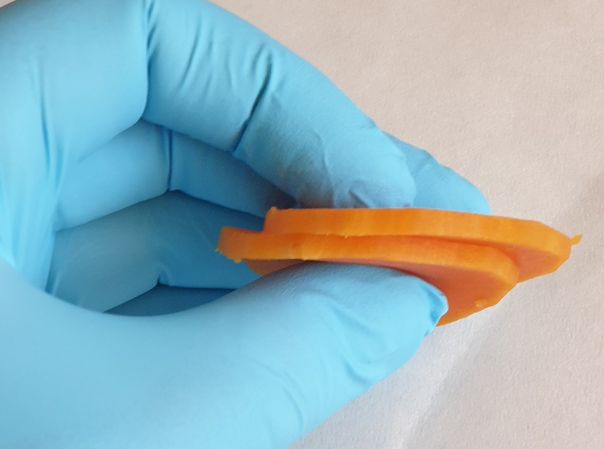
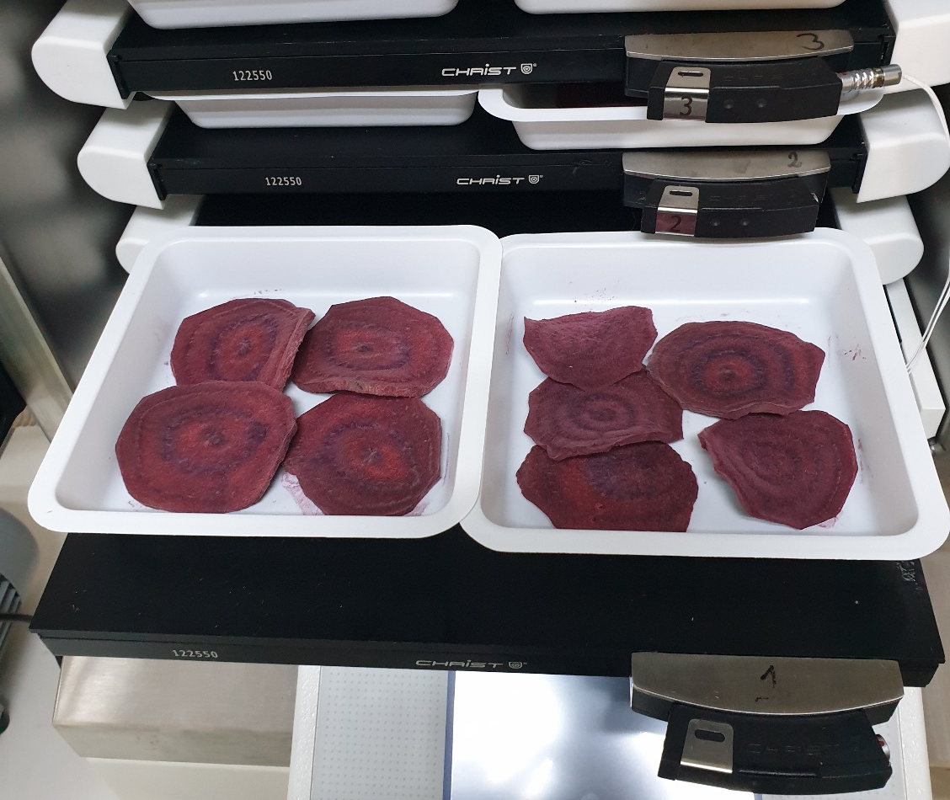
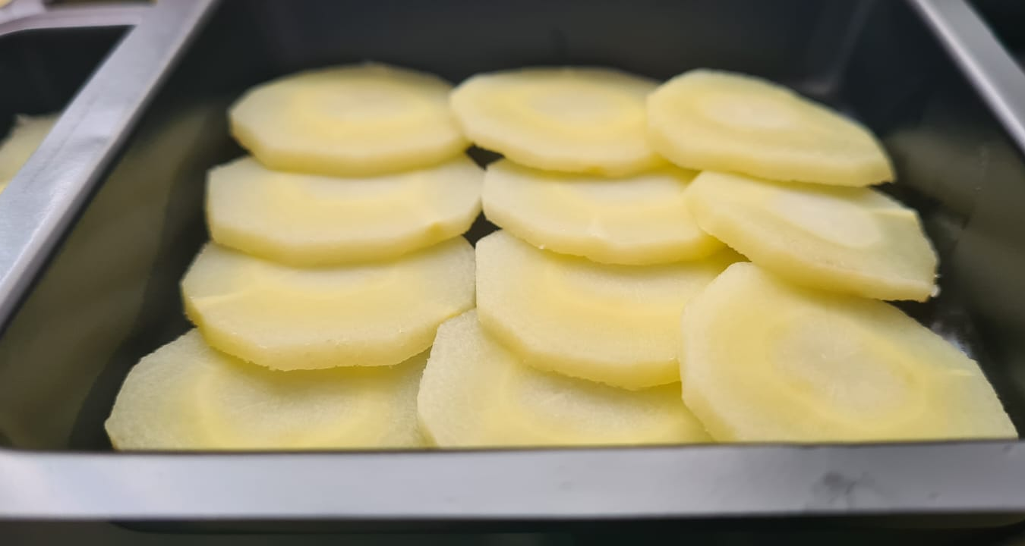
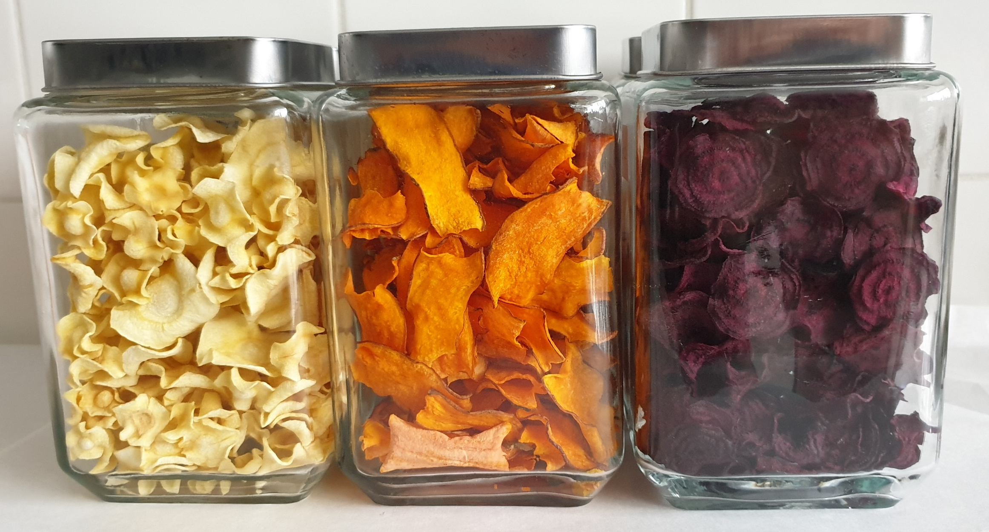
PROCESSING METHODS USED FOR ORGANIC VEGETABLE CHIPS - REVIEW
Mihai FRINCU¹, Andreea BARBU¹, Violeta Alexandra ION¹, Andrei PETRE¹, Liliana BĂDULESCU^{1,2}
¹Research Center for Studies of Food Quality and Agricultural Products, University of Agronomic Sciences and Veterinary Medicine of Bucharest, Romania
² Faculty of Horticulture, University of Agronomic Sciences and Veterinary Medicine of Bucharest, Romania
59 Marasti Blvd, District 1, 011464, Bucharest, Romania, andreea.stan@qlab.usamv.ro
Keywords: organic; vegetables; drying; chips.
INTRODUCTION
Due to their compounds and their beneficial properties for the body, vegetables are important ingredients in a balanced daily diet. By definition, vegetables are edible parts of the plant that can include: stems, roots, tubers, bulbs, leaves, flowers and beams. It is recommended to eat fresh vegetables, but when this is not possible, they can be preserved in various forms.
MATERIALS AND METHODS
One of the oldest techniques for preserving vegetables is drying, which involves reducing the water content of vegetables by exposing them to the sun or artificial heat sources. Dried vegetables are produced by different processes. In general, dried vegetables follow the same steps: selection of vegetables according to their shape and quality, peeling, slicing, preservation, dehydration (natural or artificial), sweating or salting, visual inspection and packaging. Drying is beneficial because it extends the shelf life, reduces postharvest waste, and massively helps reduce storage and transportation costs.
RESULTS AND DISCUSSIONS
Vegetable selection
Vegetable selection
Peeling
Peeling
Slicing
Slicing
Preservation
Preservation
Dehydration (natural/artificial
Lyophilization
Sweating or salting
Sweating or salting
Visual inspection
Visual inspection
Packaging
Packaging
CONCLUSIONS
This article reviews various methods of pre-processing of organic vegetables (cutting forms, different forms of bleaching, etc.) and different drying methods (classic by varying the temperature, vacuum, etc.).
ACKNOWLEDGEMENTS
This work was supported by a grant of the University of Agronomic Sciences and Veterinary Medicine of Bucharest, project number 2021-0031/14.07.2021, acronym EcoLegDry, within IPC 2021.

