Slide 1

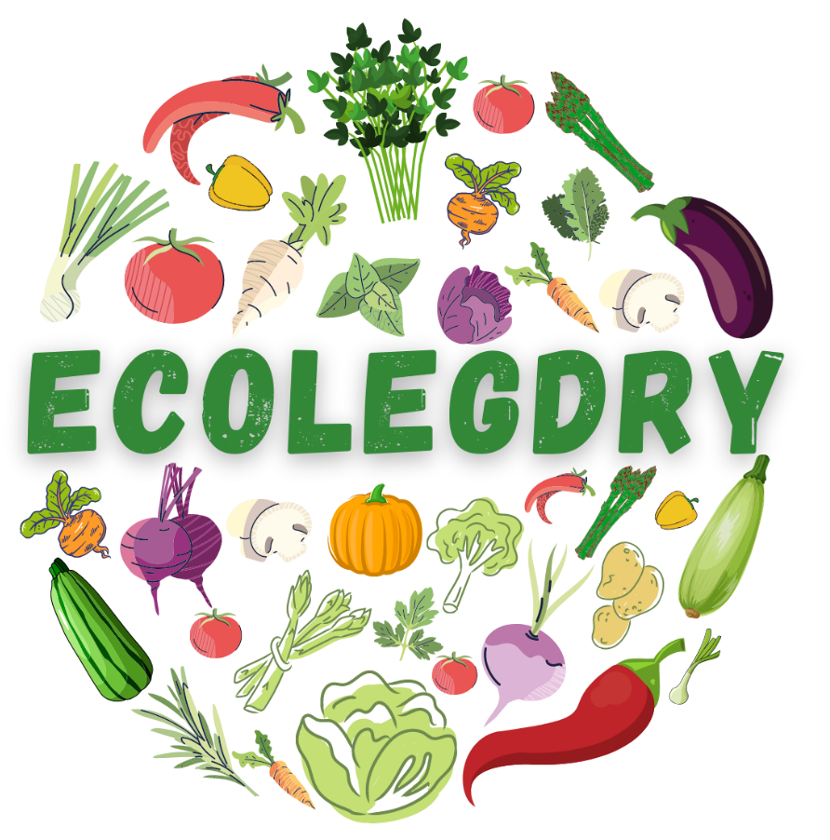

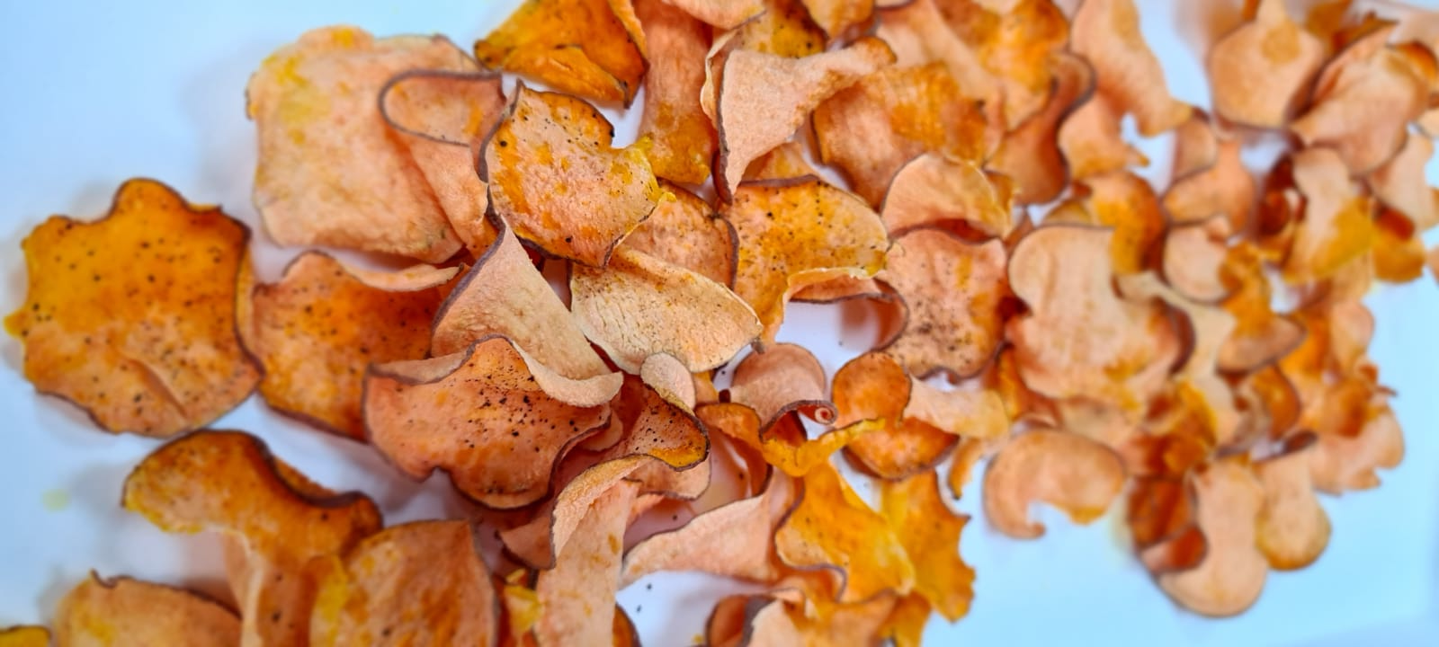
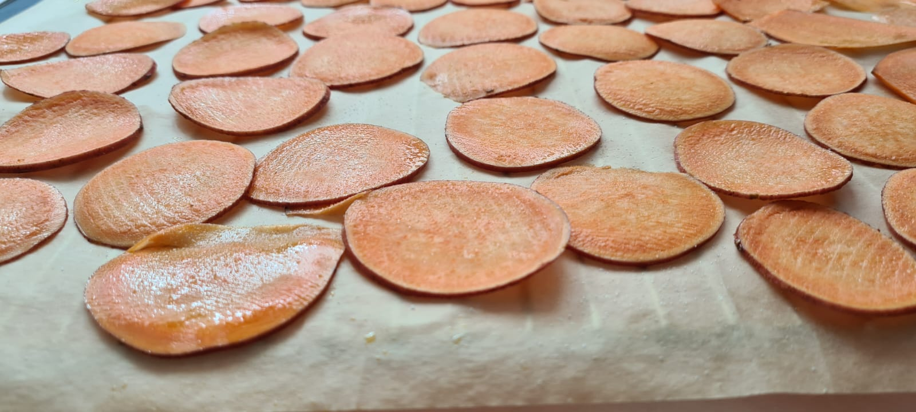
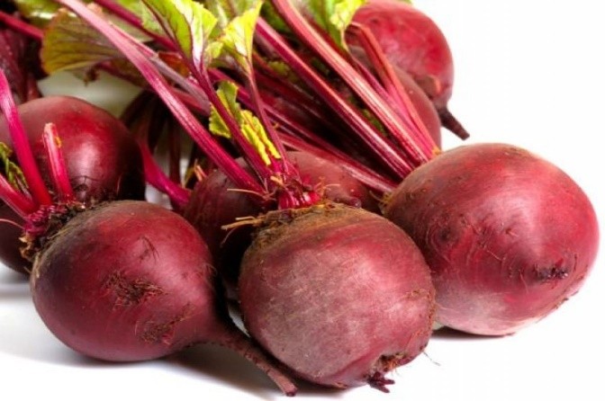
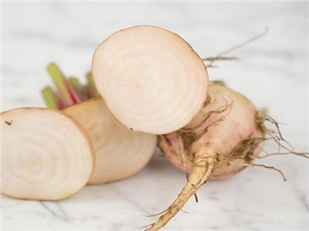
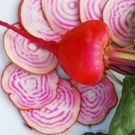
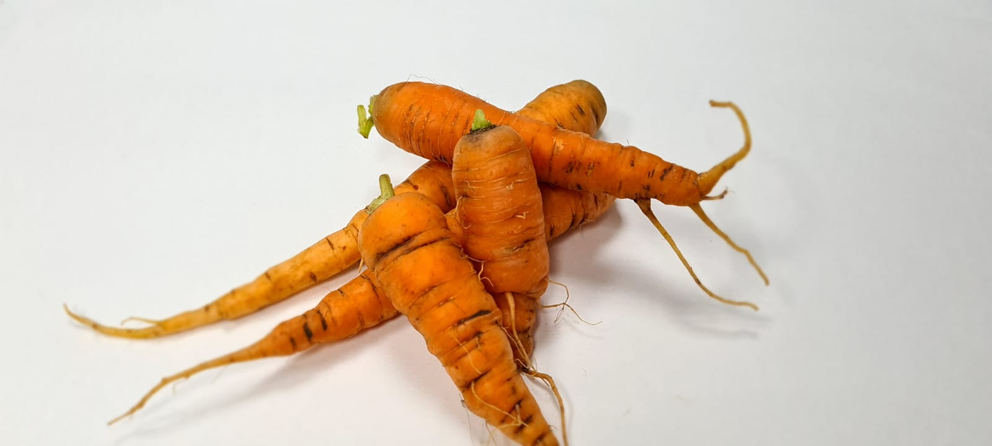
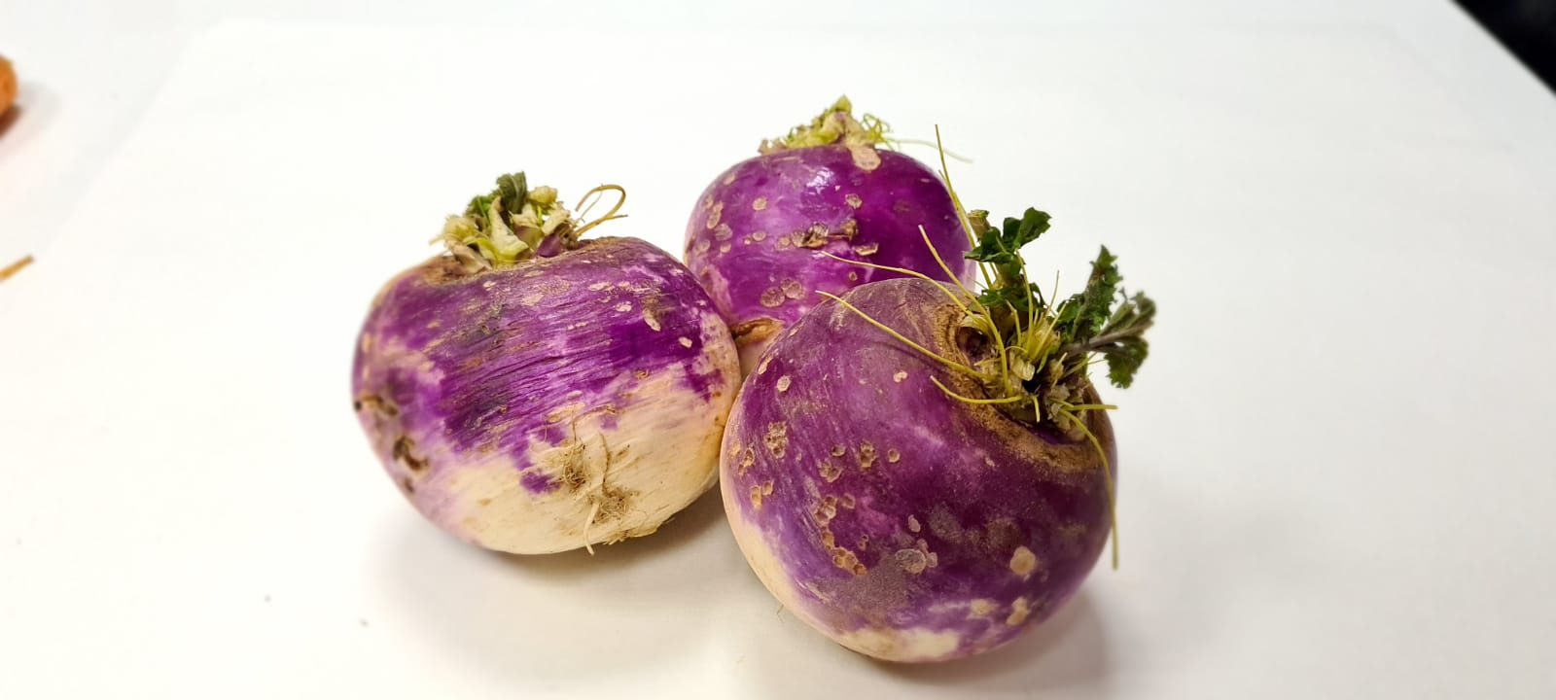
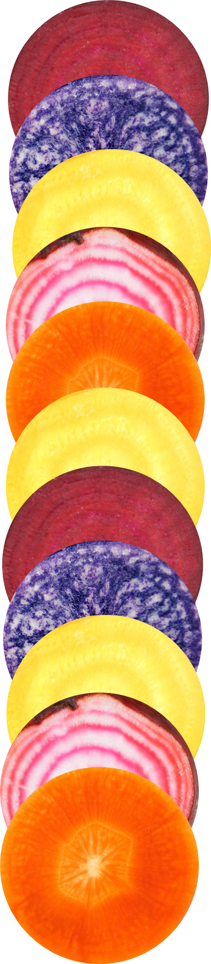
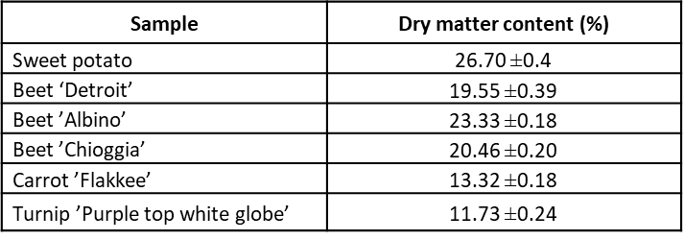
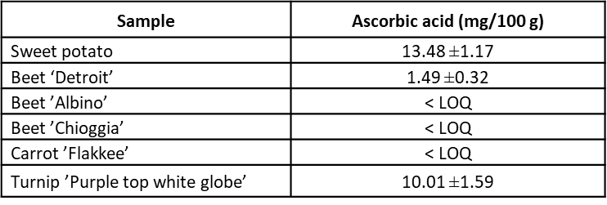
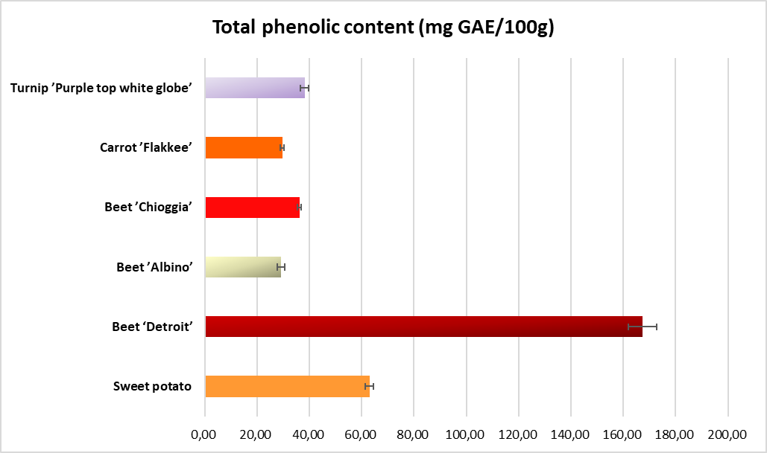
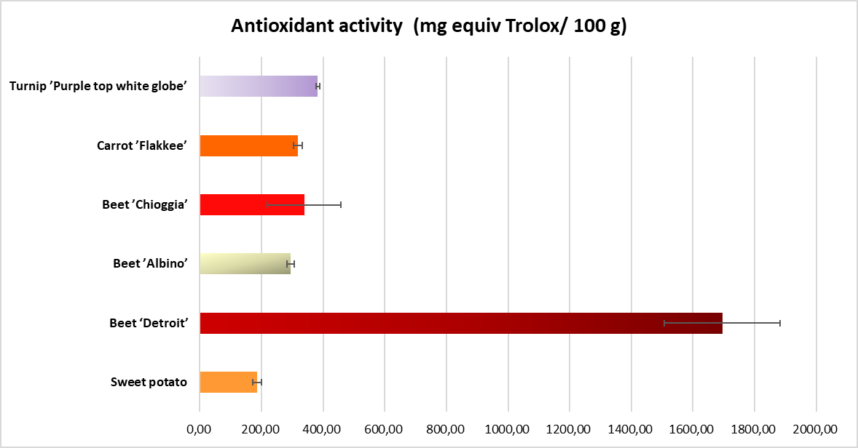
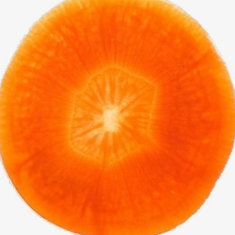
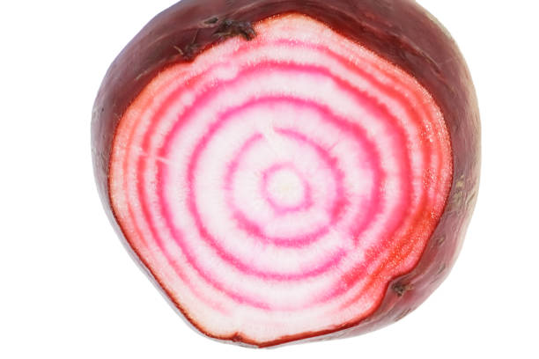
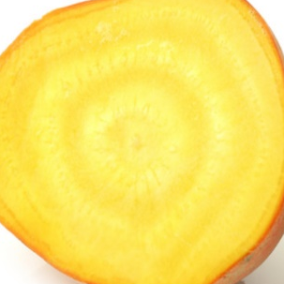
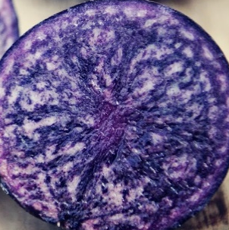
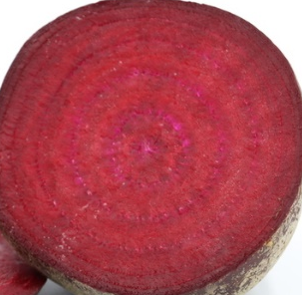
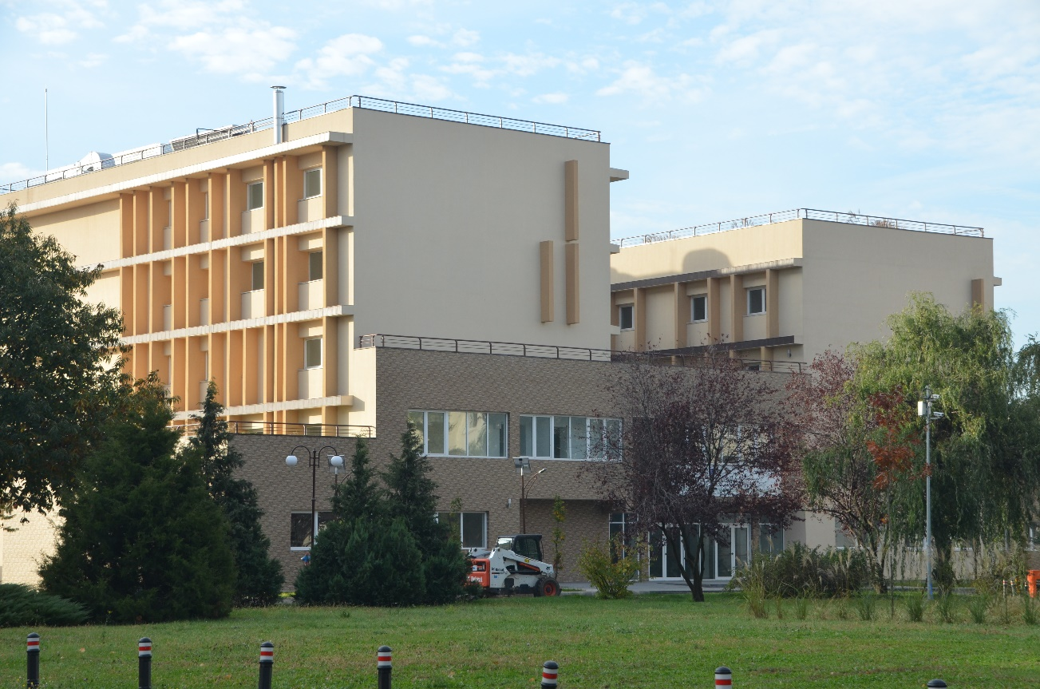
NUTRITIONAL COMPOSITION OF FRESH ORGANIC VEGETABLES
Andreea BARBU¹, Violeta Alexandra ION¹, Mihai FRÎNCU¹, Andrei PETRE¹, Liliana BĂDULESCU^{1,2}
¹Research Center for Studies of Food Quality and Agricultural Products, University of Agronomic Sciences and Veterinary Medicine of Bucharest, Romania
² Faculty of Horticulture, University of Agronomic Sciences and Veterinary Medicine of Bucharest, Romania
59 Marasti Blvd, District 1, 011464, Bucharest, Romania, andreea.stan@qlab.usamv.ro
Keywords: bioactive compounds; chips; crispy snacks; organic vegetables
INTRODUCTION
MATERIALS AND METHODS
Vegetables are important elements for rational and healthy diet due to active compounds and their nutritive values. Currently, technical progress in food industry offer new solution for processing vegetables. The purpose of this study was to determine the nutritional composition of different organic vegetables which can be used as base for healthy chips.
Several vegetables were purchased from organic certified farms such as one sweet potato variety ‘ROK1’ from Beleza Store SRL, three beets varieties ‘Detroit’, ‘Albino’ and ‘Chioggia’, one carrot variety ‘Flakkee’, and one nap variety ‘Purple top white globe’ from Grădina Corbilor SRL. Analysis like dry matter content, total phenolic content, antioxidant activity, and ascorbic acid content were performed at Research Center for Studies of Food Quality and Agricultural Products in order to characterize the organic vegetables quality.
The lowest dry matter content was registered by turnip variety ‘Purple top white globe’ with 11.73±0.24% and highest was observed for sweet potato variety ‘ROK1’ with 26.70 ±0.4%.
RESULTS AND DISCUSSIONS
The highest ascorbic acid content was registered by sweet potato followed by ‘Purple top white globe’ turnip variety. Ascorbic acid content was below limit of quantification for ‘Albino’ and ‘Chioggia’ beet varieties and for ‘Flakkee’ carrot variety.
The total phenolic content and antioxidant activity of ‘Detroit’ beets variety registered the highest values such as 167.31 ±5.37 mg GAE/100g, respectively 1694.83 ±188.76 mg equiv Trolox/ 100 g, followed by sweet potato with 62.96 ±1.60 mg GAE/100g and turnip variety ‘Purple top white globe’ with 382.75 ±5.23 mg equiv Trolox/ 100 g.
CONCLUSIONS
When comparing the vegetables in terms of total phenolic content and antioxidant activity, ‘Detroit’ beets variety registered the highest values, followed by sweet potato and turnip.
The ascorbic acid content of sweet potato registered the highest values, but the ‘Detroit’ and ‘Albino’ beets varieties registered values below limit of quantification.
The total phenolic content and antioxidant activity registered similar trend for all analysed samples.
All studied organic vegetables can be successfully used for healthy crispy snacks.
Contact
Project manager: CS III dr. ing. Andrea Barbu
Email: andreea.stan@qlab.usamv.ro
Phone: +40 769 716 512
Website: https://www.usamv.ro/index.php/ro/cercetare/competitie-interna-proiecte-cercetare-2021#contact
ACKNOWLEDGEMENTS: This work was supported by a grant of the University of Agronomic Sciences and Veterinary Medicine of Bucharest, project number 2021-0031/14.07.2021, acronym EcoLegDry, within IPC 2021.

